Slide 1
Chapter 4: Interactive facilities of z/OS:
TSO/E, ISPF, and UNIX
58
Notes:
We’ve mentioned that z/OS is ideal for processing batch jobs – workloads that run in the background with little if any human interaction. However, z/OS is just as much an interactive operating system as it a batch processing system. By interactive, we mean that end-users (sometimes tens of thousands of concurrent end-users, in the case of z/OS) using the system in real-time through direct interaction, such as commands and menu style interfaces.
Everyone who works with z/OS needs to know its end-user interfaces. Chief among these is TSO/E and its menu-driven interface, ISPF. These programs allow you to log on to the system, run programs, and work with data files. Also, you will need to know the interactive facilities of the z/OS implementation of UNIX interfaces, known collectively as z/OS UNIX System Services, or “z/OS UNIX” for short.

Slide 2
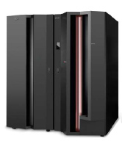
Chapter objectives
Be able to:
Log on to z/OS
Run programs from the TSO READY prompt
Navigate through the menu options of ISPF
Use the ISPF editor to make changes to a file
Use the UNIX interfaces provided on z/OS, including the z/OS UNIX command shell.
Notes:
z/OS provides a number of facilities to allow users to interact directly with the operating system. This chapter provides an overview of each facility. Hands-on exercises are provided at the end of the chapter to help students develop their understanding of these important facilities.

Slide 3
Key terms in this chapter
3270 and 3270 emulator
CLIST
ISHELL
ISPF
logon
native mode
OMVS command
path
password
READY prompt
record
Restructured Extended Executor (REXX)
root
SDSF
shell
Time Sharing Option / Extensions (TSO/E)
user ID
Notes:
Tips:
3270 refers to a hardware console display, but often this display (or “green screen”) is emulated through a 3270 emulator program.
In a z/OS file (data set), each line of text is known as a record.
TSO is what makes the z/OS operating system interactive (not just batch-oriented).

Slide 4
How do we interact with z/OS?
Screenshot 1
TSO/E
Allows users to logon to z/OS and use a limited set of basic commands. This is sometimes called using TSO in its native mode.
ISPF
Provides a menu system for accessing many of the most commonly used z/OS functions.
z/OS UNIX shell and utilities
Allows users to write and invoke shell scripts and utilities, and use the shell programming language.
Notes:
z/OS provides a number of facilities to allow users to interact directly with the operating system. In this education module, we’ll look at each facility briefly. At the end, we’ll work through some simple exercises to give the student some hands-on experience with z/OS.
TSO allows users to log on to z/OS and access a limited set of basic TSO commands, which are available as part of the core operating system. Interacting with z/OS in this way is called using TSO in its native mode.
ISPF is an application that runs on z/OS and provides a menu-style shell for TSO users. ISPF menus list the functions that are most frequently needed by online users. ISPF is what many people use exclusively to perform work on z/OS.
The z/OS UNIX shell and utilities allow users to write and invoke shell scripts and utilities, and use the shell programming language.
Hands-on exercises are provided at the end of the chapter to help students develop their understanding of these important facilities.

Slide 5
TSO overview
TSO/E
  Acronym for Time Sharing Option/Extensions (TSO/E)
  Allows users to create an interactive session with z/OS
  Provides a single-user logon capability and a basic command prompt interface to z/OS
  Most users work with TSO through its menu-driven interface, Interactive System Productivity Facility (ISPF)
Notes:
Most z/OS users refer to TSO/E as simply “TSO,” and that is how it is called in this textbook. Also, we use the word “user” to mean “end user.”
What is TSO? It’s what allows users to create an interactive session with the z/OS system. TSO provides a single-user logon capability and a basic command prompt interface to z/OS.
Most users work with TSO through its menu-driven interface, Interactive System Productivity Facility (ISPF). This collection of menus and panels offers a wide range of functions to assist users in working with data files on the system. ISPF users include
system programmers, application programmers, administrators, and others who access z/OS. In general, TSO and ISPF make it easier for people with varying levels of experience to interact with the z/OS system.

Slide 6
TSO overview (continued)
In a z/OS system, each user gets a user ID and a password authorized for TSO logon.
During TSO logon, the system displays the TSO logon screen on the user’s 3270 display device or TN3270 emulator.
z/OS system programmers modify the layout and text of the TSO logon panel to better suit the needs of the system’s users.
Notes:
In a z/OS system, each user is granted a user ID and a password authorized for TSO logon. Logging on to TSO requires a 3270 display device or, more commonly, a TN3270 emulator running on a PC. During TSO logon, the system displays the TSO logon screen on the user’s 3270 display device or TN3270 emulator. The logon screen serves the same purpose as a Windows logon panel.
z/OS system programmers often modify the particular text layout and information of the TSO logon panel to better suit the needs of the system’s users. Therefore, the screen captures shown on these slides might differ from what you would see on a real-life production system.
Let’s look at a typical example of a TSO logon screen (next slide).

Slide 7
TSO/E logon screen
------------------------------- TSO/E LOGON -----------------------------------
Enter LOGON parameters below: RACF LOGON parameters:
Userid ===> ZPROF
Password ===> New Password ===>
Procedure ===> IKJACCNT Group Ident ===>
Acct Nmbr ===> ACCNT#
Size ===> 860000
Perform ===>
Command ===>
Enter an 'S' before each option desired below:
-Nomail -Nonotice -Reconnect -OIDcard
PF1/PF13 ==> Help PF3/PF15 ==> Logoff PA1 ==> Attention PA2 ==> Reshow
You may request specific help information by entering a '?' in any entry field
Notes:
Logon proc allocates the data sets you’ll need, the resources you can access (RACF), the region size for your address space.
Use reconnect if you lose your connection.
Notice the PF Keys? Many of the screen capture examples used in this textbook show program function (PF) key settings. Because it is common practice for z/OS sites to customize the PF key assignments to suit their needs, the key assignments shown in this textbook might not match the PF key settings in use at your site.
We’ll look at the PF key assignments used in this course in a slide coming up.

Slide 8

Using TSO commands in native mode
Usually, ISPF provides the interface for TSO.
However, TSO includes a limited set of basic commands independent of ISPF and other programs.
Using TSO in this way is called using
TSO in its native mode.
When you logon to TSO, the z/OS system responds by displaying the READY prompt, and waits for input (similar to a DOS prompt).
READY _
Notes:
Most z/OS sites prefer to have the TSO user session automatically switch to the ISPF interface after TSO logon. This section, however, briefly discusses the limited set of basic TSO commands available independent of other complimentary programs, such as ISPF. Using TSO in this way is called using TSO in its native mode.
Native TSO is similar to the interface offered by the native DOS prompt. TSO also includes a very basic line mode editor, in contrast to the full screen editor offered by ISPF.
The next slide shows an example of a user entering commands at the READY prompt to sort data.

Slide 9
Terminology for data files
z/OS files are called data sets. Before you can write data into them, space for data sets must be reserved on disk. The user is involved in specifying the amount of space as well as the formatting of it. Here are some of the terms used when allocating a data set.
Volume serial - A six character name of a disk or tape volume, such as TEST01
Device type - A model or type of disk device, such as 3390
Organization - The method of processing a data set, such as sequential
Record format - The data is stored in chunks called records, of either fixed or variable length
Record length - The length (number of characters) in each record
Block size- If records are joined together to save space, this specifies the length of the block in characters
Extent - An allocation of space to hold the data. When the primary extent is filled, the operating system will automatically allocate more extents, called secondaries
Space - Disk space is allocated in units called blocks, tracks, or cylinders

Slide 10
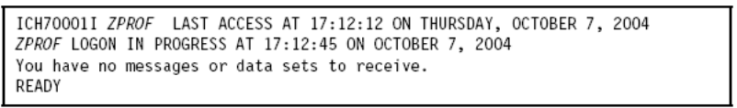
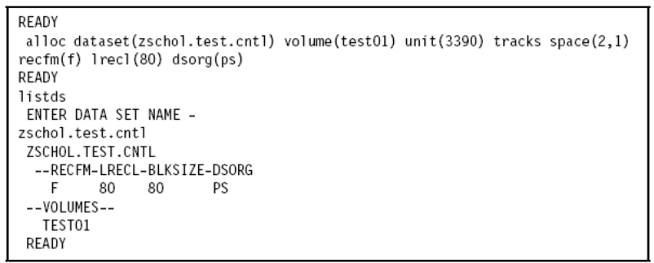
T S O
TSO Logon READY prompt
Allocating a dataset from the TSO Command Line

Slide 11
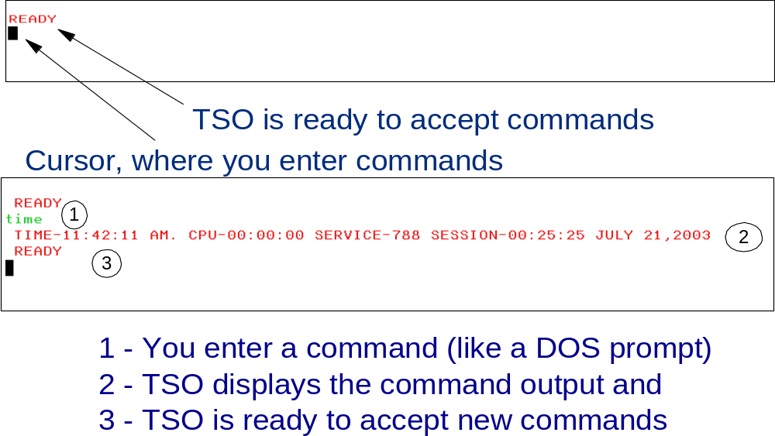
TSO Ready Prompt
Notes:
The READY prompt accepts simple line commands such as HELP, RENAME, ALLOCATE, and CALL.

Slide 12
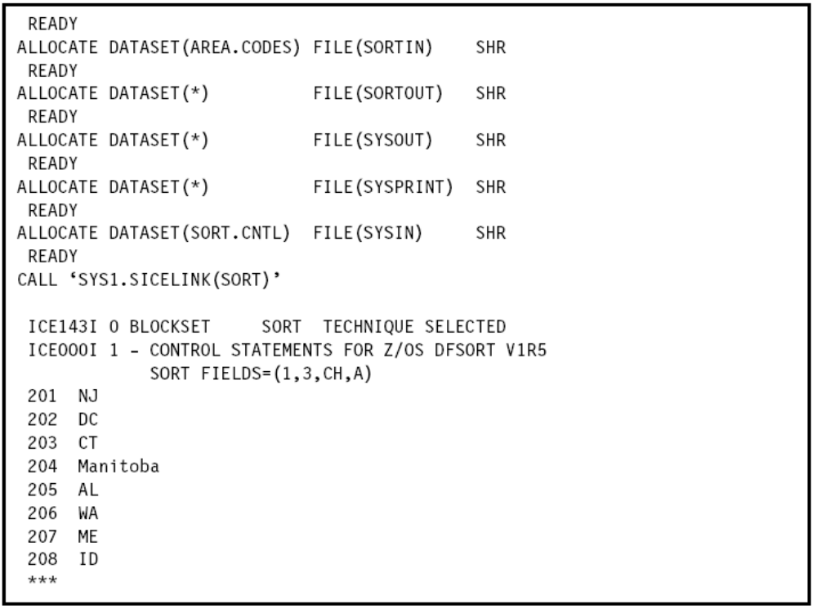
Using native TSO commands to SORT Data

Slide 13

Programming using TSO/E
CLIST
REXX Exec
Command Processor

Slide 14
What is a CLIST (Command List)
CLIST is a high-level interpretive language that enables you to work more
efficiently with TSO/E that can handle any number of tasks.
Because the CLIST language is an interpretive language, CLISTs are very
easy to test and do NOT require a compile.
execute
correct <any> errors
re-execute
Write structured programs, perform I/O, handle exceptions and attention interruptions
Arithmetic and logical operations on numeric data
String handling functions for processing character data
Can perform routine tasks (i.e. dataset allocation)
Provides for interactive applications using ISPF* (see later in this topic)
* Interactive System Productivity Facility
Notes:
With native TSO, it is possible to place a list of commands, called a command list or CLIST (pronounced “see list”) in a file, and execute the list as if it were one command. When you invoke a CLIST, it issues the TSO/E commands in sequence. CLISTs are used for performing routine tasks; they enable users to work more efficiently with TSO.
TSO users create CLISTs with the CLIST command language. Another command language used with TSO is called Restructured Extended Executor or REXX. When you invoke a CLIST, it issues the TSO/E commands in sequence. CLISTs are used for performing routine tasks; they enable users to work more efficiently with TSO.

Slide 15
What is a REXX Exec (a.k.a. execs)?
like CLISTs
The REstructured eXtended eXecutor (REXX) language is a high level
interpretive language that enables you to write programs in a clear and
structured way.
You can perform numerous tasks such a invoking programs written in other
languages.
Perform I/O and process arithmetic and character data
Write interactive applications using ISPF

Slide 16

CLISTs versus REXX
CLIST execute only in a TSO/E environment where REXX can execute in any MVS address space
REXX is Restructured Extended Executor language, a command language used with TSO
REXX is the implementation of the Systems Application Architecture (SAA) Procedures Language, therefore you can write REXX execs that will run in any supported SAA SAA environments - i.e. zVM/SP (CMS)
Both CLISTs and REXX offer shell script-type processing.
Both are interpretive languages, not compiled languages (although REXX can be compiled as well).
Some z/OS users write functions directly as CLISTs or REXX programs
CLIST programming is unique to z/OS, while the REXX language is used on many platforms.
CLIST
REXX
Notes:
Another command language used with TSO is called Restructured Extended Executor or REXX. Both CLIST
and REXX offer shell script-type processing. These are interpretive languages, as opposed to compiled languages (although REXX can be compiled as well).
Some TSO users write functions directly as CLISTs or REXX programs, but these are more commonly implemented as ISPF functions, or by various software products. CLIST programming is unique to z/OS, while the REXX language is used on many platforms.

Slide 17
Example of REXX Exec
File Edit Edit_Settings Menu Utilities Compilers Test Help
------------------------------------------------------------------------------------
EDIT KETTNER.REXX.CLIST(MYOMVS) - 01.00 Columns 00001 00072
Command ===> Scroll ===> PAGE
****** ************************* Top of Data ******************************
000100 /* REXX OMVS */
000200 p = prompt("on"); /* dont suppress prompting */
000300 "omvs sessions(3) noshareas";
000400 x = prompt(p); /* restore original prompt state */
000500 return;
****** ************************ Bottom of Data ****************************

Slide 18

TSO/E Command Processor
TSO/E provides commands that allows you to perform a wide
variety of tasks.
You can define a Command Processor to enhance defining and
maintaining datasets and to write and test programs.
You can write a command processor to replace or add to TSO
set of commands
A Command Processor is a program that is given control by the
terminal monitor program (TMP) when a user at a terminal enters a command
The TMP provides the interface between terminal users and the command
processor providing many system services.
TMP
NOTE: As an example of a Command Processor – when you log on to TSO/E, the program specifies on the EXEC
statement of the user’s logon procedure is attached as the TMP. After the Logon is completed, the TMP
writes a READY message to the terminal for you to enter a command name.

Slide 19
ISPF overview
Acronym for Interactive System Productivity Facility
ISPF is a menu-driven interface for user interaction with z/OS system. The ISPF environment is executed from native TSO.
ISPF provides utilities, an editor and ISPF applications to the user. To the extent permitted by various security controls an ISPF user has full access to most z/OS system functions.
Notes:
After logging on to TSO, users typically access the ISPF menu. In fact, many use ISPF exclusively for performing work on z/OS. ISPF is a full panel application navigated by keyboard. ISPF includes a text editor and browser, and functions for locating and listing files and performing other utility functions. ISPF menus list the functions that are most frequently needed by online users.

Slide 20
Navigating through ISPF menus
To access ISPF under TSO, the user enters a command from the READY prompt to display the ISPF Primary Option Menu.
You can access online help from any of the ISPF panels (press the PF1 key)
ISPF includes a text editor and browser, and functions for locating files and performing other utility functions.
Notes:
<No notes>

Slide 21
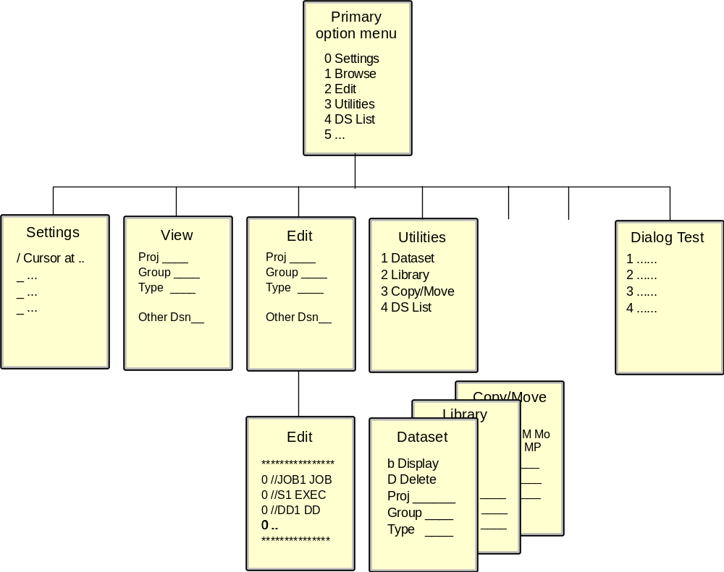
ISPF Menu Structure
Notes:
As you can see, ISPF has a “tree structure.” Some UNIX users call this menu structure a “captive” interface.
The Primary Option menu is at the top of the tree. This panel can be customized with additional options by the local system programmer. Therefore, it varies in features and content from site to site.

Slide 22
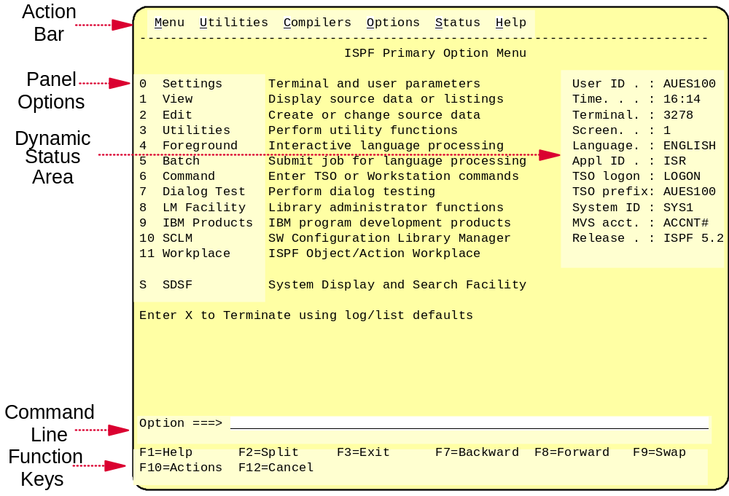
General structure of ISPF panels
Notes:
Option zero (O) allows you to change ISPF settings. For example, the command line for your ISPF session might appear at the bottom of the display, while your instructor’s ISPF command line might appear at the top. This is a personal preference, but traditional usage places it at the top of the panel. If you want your command line to appear at the top of the panel, do the following:
Go to the ISPF primary option menu.
Select option 0 to display the Settings menu, as shown in Figure 3-17 on page 3-22.
In the list of Options, remove the “/” on the line that says “Command line at bottom.” Use the Tab or New line key to move the cursor.

Slide 23
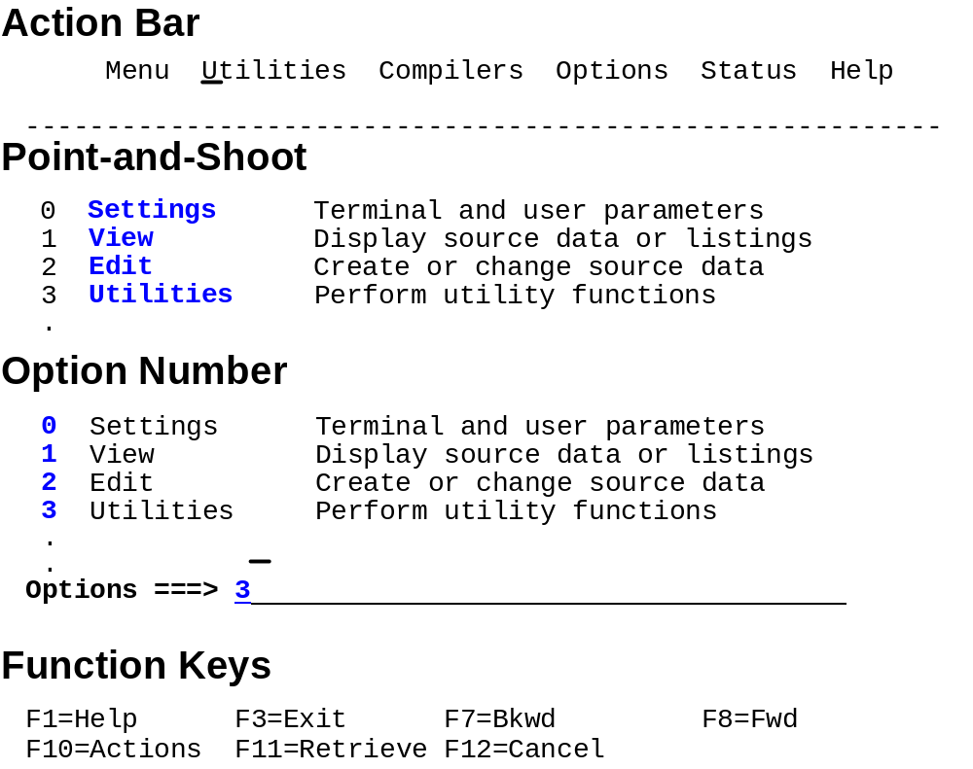
Common functions provided in ISPF menus…

Slide 24
Keyboard mapping:
Function Key
Enter Ctrl (right side)
Exit, end, or return PF3
Help PF1
PA1 or Attention Alt-Ins or Esc
PA2 Alt-Home
Cursor movement Tab or Enter
Clear Pause
Page up PF7
Page down PF8
Scroll left PF10
Scroll right PF11
Reset locked keyboard Ctrl (left side)
Notes:
Many of the screen capture examples used in this course show ISPF program function (PF) key settings at the bottom of the panel. Because it is common for z/OS users to customize the PF key assignments to suit their needs, the key assignments shown in this course might not match the PF key settings in use at another z/OS site. Actual function key settings vary from customer to customer.
This slide lists some of the most frequently used PF keys and other keyboard functions and their corresponding keys.
From the ISPF Primary Menu, press the PF1 HELP key to display the ISPF tutorial. New users of ISPF should acquaint themselves with the tutorial (Figure 3-11) and with the extensive online help facilities of ISPF.

Slide 25
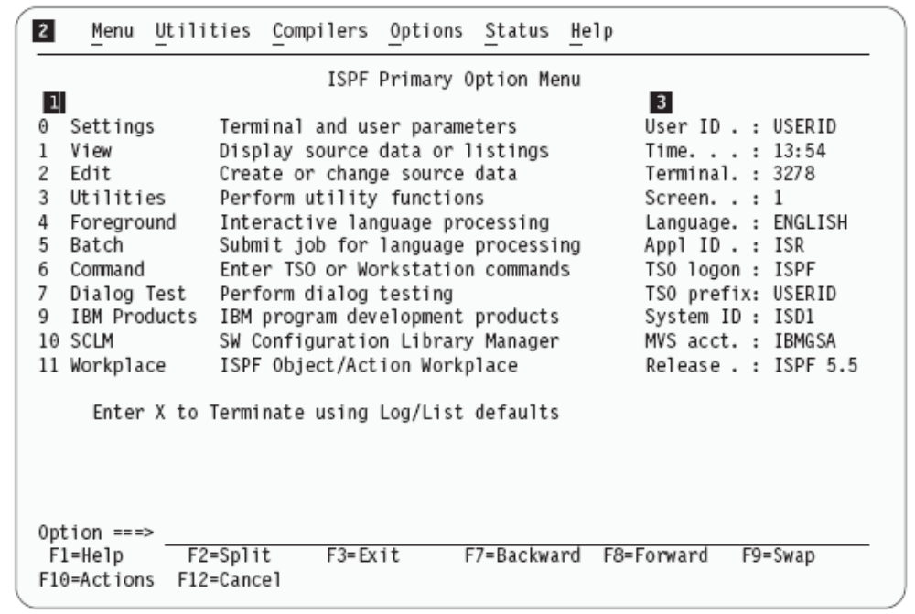
Primary Option Menu
Note: Some ISPF
POM panels may
likely provide
copyright
acknowledgement
Depress ENTER
to remove
License material – Property of IBM
All Rights Reserved .
1
Primary Options
2
Action Bar
3
Dynamic Status Area
2
2

Slide 26
Primary Option Menu
Logon
Procedure
Logon
ID
1
Primary Options
2
Action Bar
3
Dynamic Status Area
2
2

Slide 27
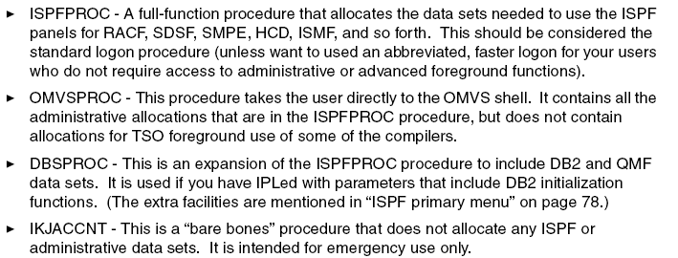
TSO Logon Procedures
(i.e. unix profile)
example

Slide 28
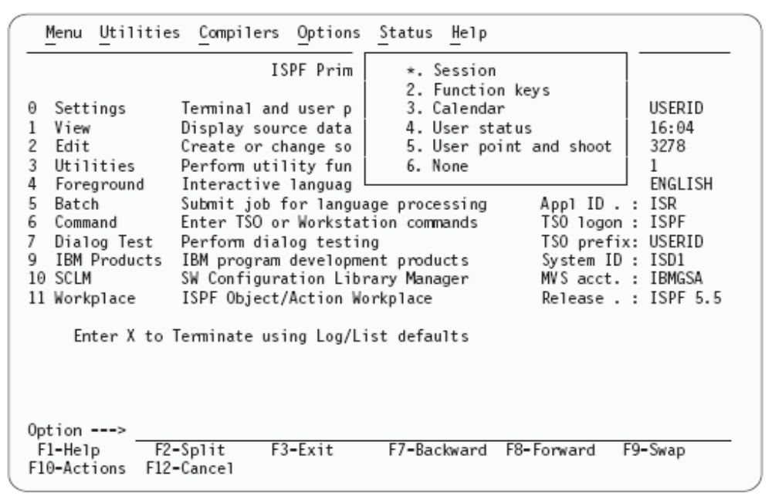
Status pull-down

Slide 29
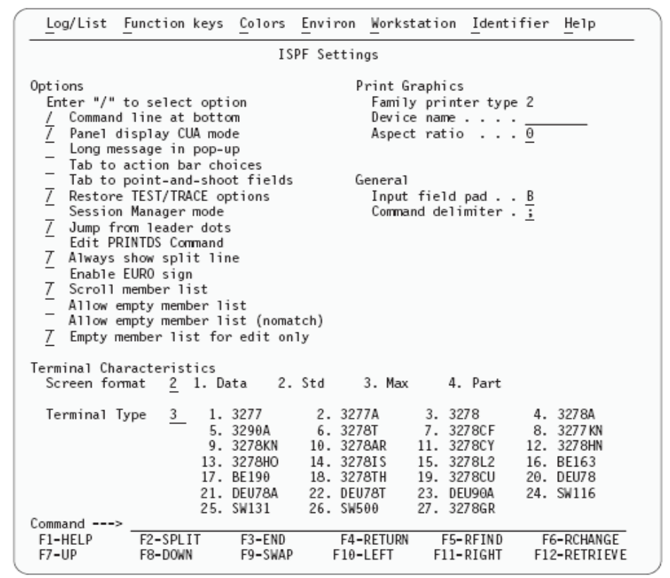
Option 0 ISPF Session Settings

Slide 30
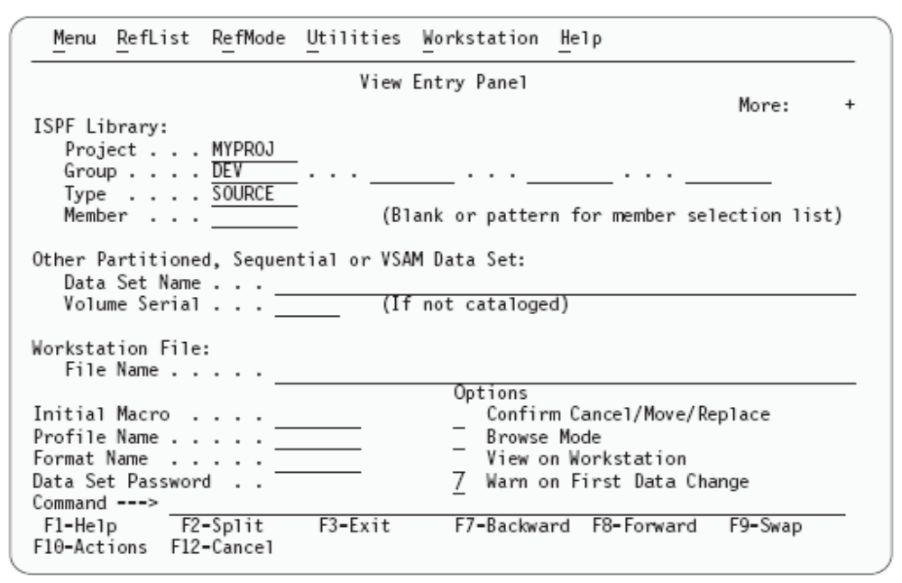
Option 1 VIEW

Slide 31
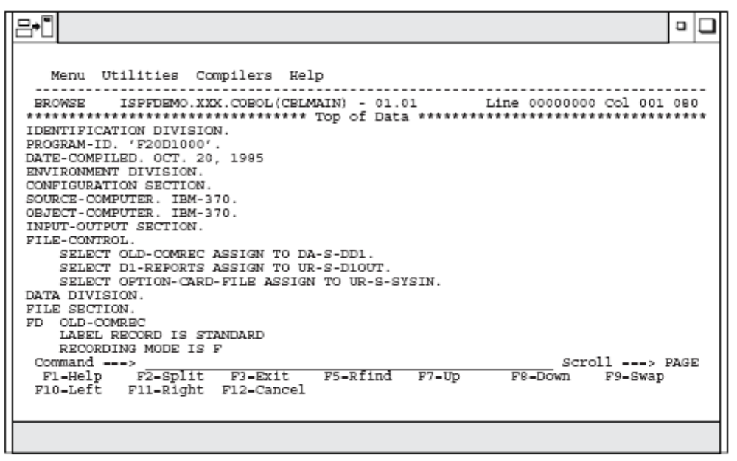
Option 1 VIEW
Browsing – data display

Slide 32
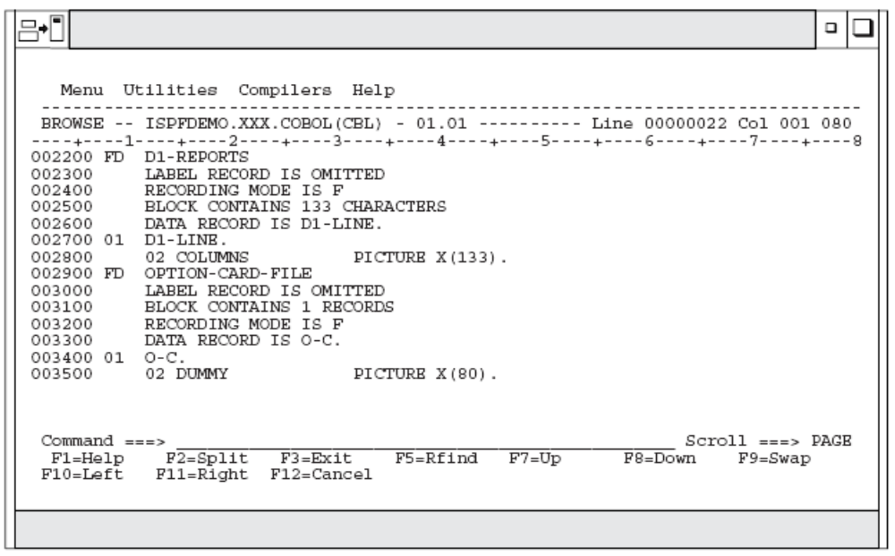
Option 2 V I E W
COLS
Place keyword COLS on the command line

Slide 33
Type RESET to remove columns assist
VIEW ETP.PELPLEXU.PARMLIB(MSTJCLPU) - 01.18 Columns 00001 00072
Command ===> RESET Scroll ===> PAGE
=COLS> ----+----1----+----2----+----3----+----4----+----5----+----6----+----7--
****** ***************************** Top of Data ******************************
000100 //MSTJCLPU JOB MSGLEVEL=(1,1),TIME=1440
000200 // EXEC PGM=IEEMB860,DPRTY=(15,15)
000300 //STCINRDR DD SYSOUT=(A,INTRDR)
000400 //TSOINRDR DD SYSOUT=(A,INTRDR)
000500 //IEFPDSI DD DSN=ETP.PELPLEXU.PROCLIB,
000550// DISP=SHR,UNIT=3390,VOL=SER=ETP013
000510 // DD DSN=SYS1.PROCLIB,DISP=SHR
000700 //SYSLBC DD DSN=SYS1.BRODCAST,DISP=SHR
000800 /*
****** **************************** Bottom of Data ****************************

Slide 34
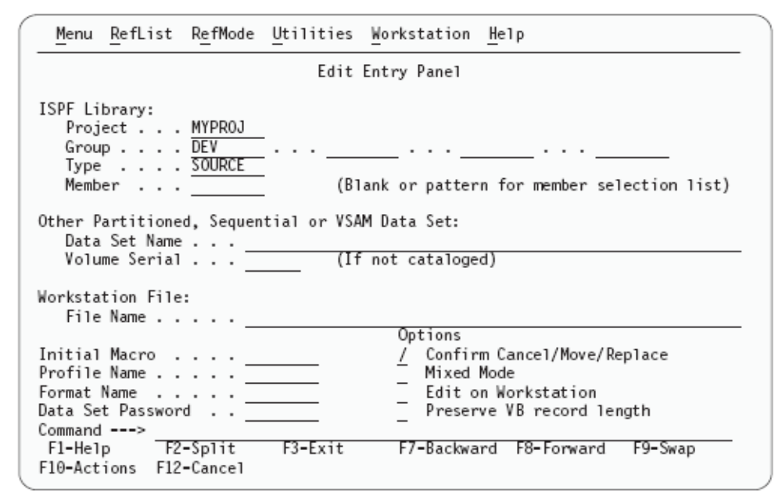
Option 2 E D I T
If you have made a connection to the workstation, you can specify a workstation file name, for example
C: \AUTOEXEC.BAT,
in this field.
C:\AUTOEXEC.BAT

Slide 35
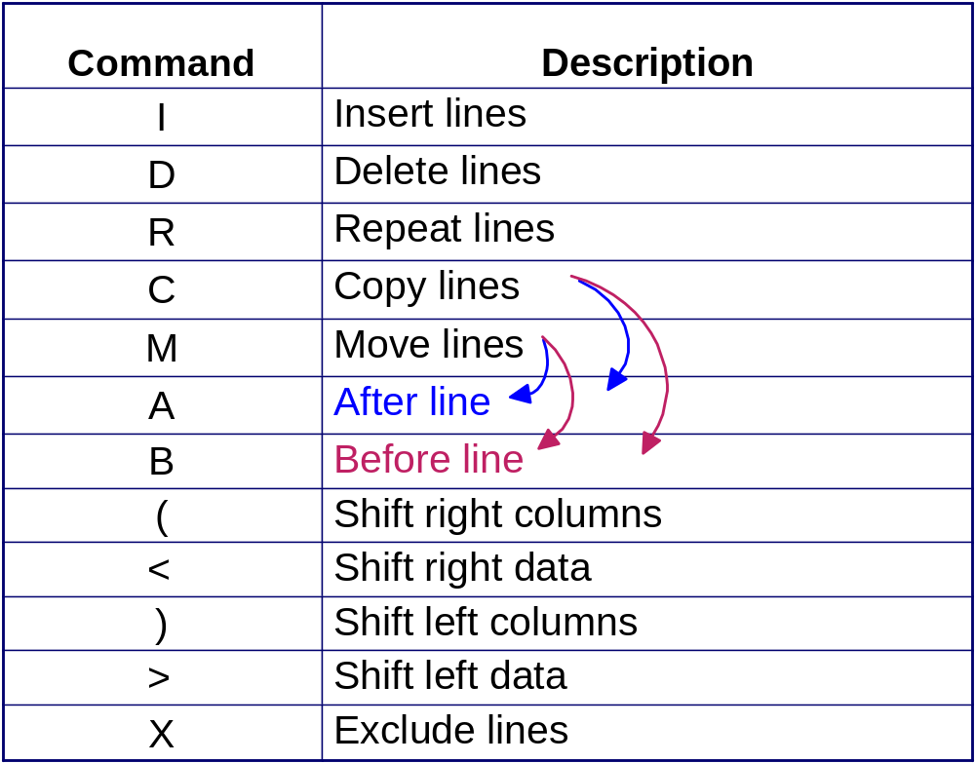
ISPF Edit Panel - some line commands
Notes:
From ISPF, you can view a data set’s contents (v to view) or edit a data set’s contents (e to edit).
When editing a data set, you use line commands to work with the contents of the file, as shown on this slide. For example:
To edit the contents of a data set, move the cursor to the area of the record to be changed and type over the existing text.
To find and change text, you can enter commands on the editor command line.
To insert, copy, delete, or move text, place these commands directly on the line numbers where the action should occur.
To commit your changes, use PF3 or save. To exit the data set without saving your changes, enter Cancel on the edit command line.

Slide 36
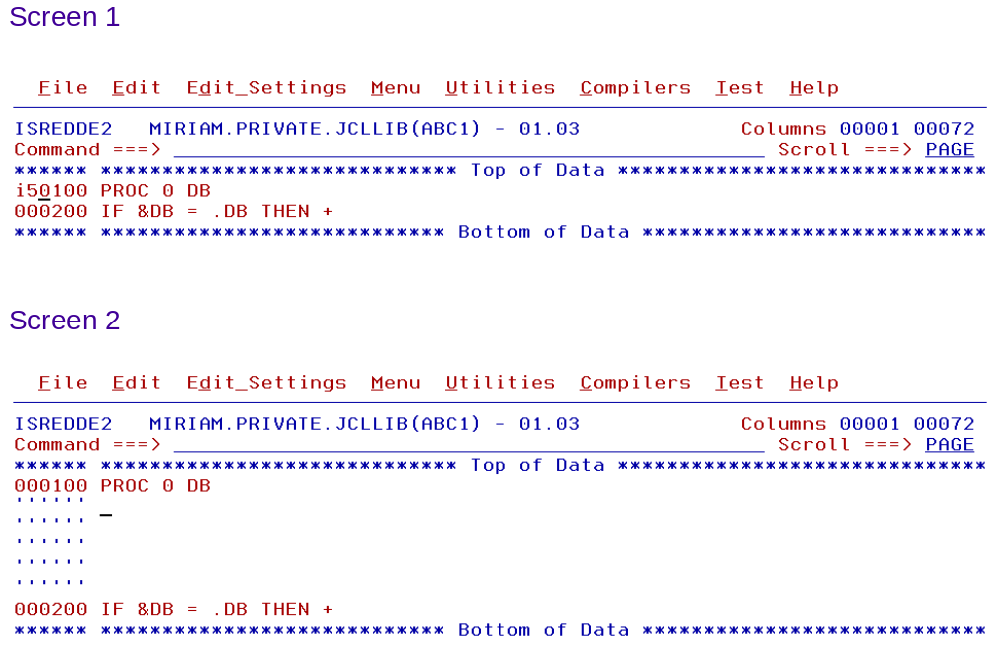
ISPF Edit Panel - Inserting lines
Notes:
This slide shows the contents of a data set opened in edit mode. Here, the use enter I5 to insert 5 blank lines after the first record.
Note the line numbers, the text area, and the editor command line. Primary command line, line commands placed on the line numbers, and text overtype are three different ways in which you can modify the contents of the data set. Line numbers increment by 10 with the ISPF editor so that the user can insert nine more lines between each current line without having to renumber the program.

Slide 37
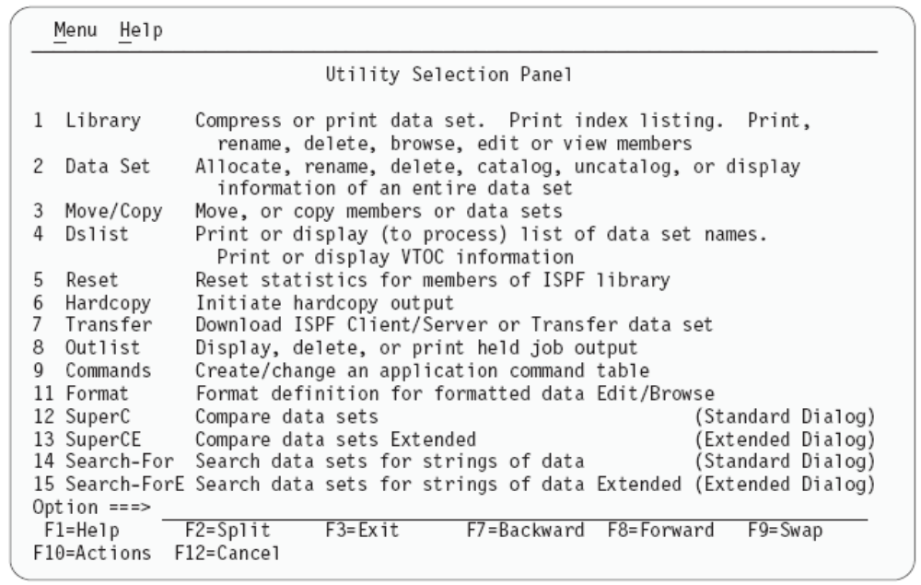
Option 3 UTILITIES

Slide 38
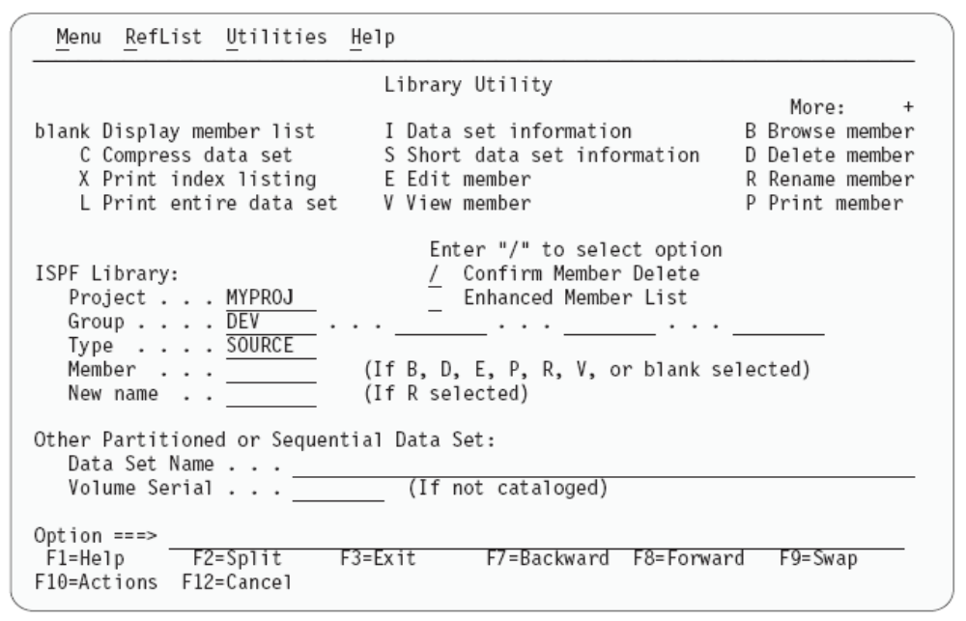
Option 3. 1 UTILITIES

Slide 39
Using ISPF allocate screen
Menu RefList Utilities Help
Allocate New Data Set
Command ===>
Data Set Name . . . : ZSCHOL.TEST.CNTL
Management class . . . (Blank for default management class)
Storage class . . . . (Blank for default storage class)
Volume serial . . . . EBBER1 (Blank for system default volume) **
Device type . . . . . (Generic unit or device address) **
Data class . . . . . . (Blank for default data class)
Space units . . . . . TRACK (BLKS, TRKS, CYLS, KB, MB, BYTES
or RECORDS)
Average record unit (M, K, or U)
Primary quantity . . 2 (In above units)
Secondary quantity 1 (In above units)
Directory blocks . . 0 (Zero for sequential data set) *
Record format . . . . FB
Record length . . . . 80
Block size . . . . . 27920
Data set name type : (LIBRARY, HFS, PDS, or blank) *
F1=Help F2=Split F3=Exit F7=Backward F8=Forward F9=Swap
F10=Actions F12=Cancel
.
Notes:
This screen shows an ISPF panel being used to allocate (create) a file (data set). This is a similar data set allocated with ISPF screens.
You can demo both of these to show the differences (interface) and similarities (result).

Slide 40
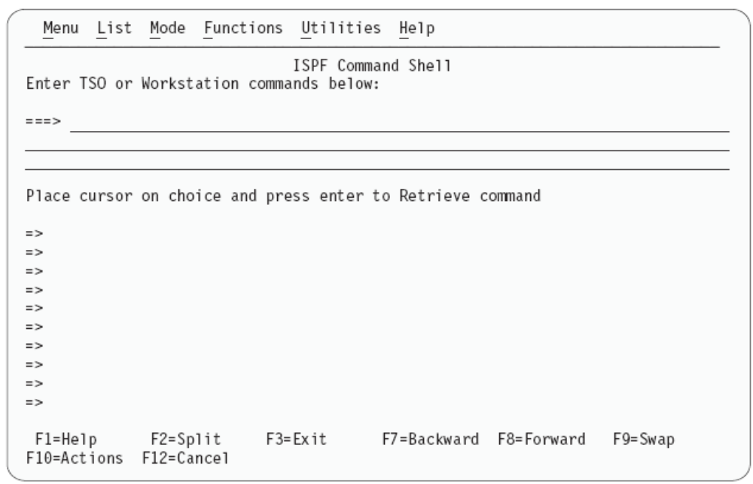
Option 6 T S O command

Slide 41
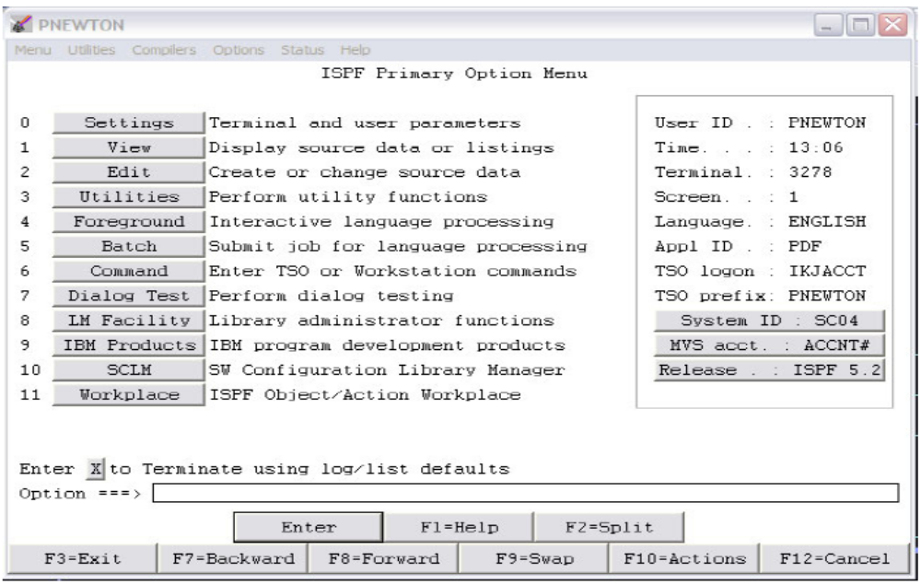
I S P F GUI

Slide 42
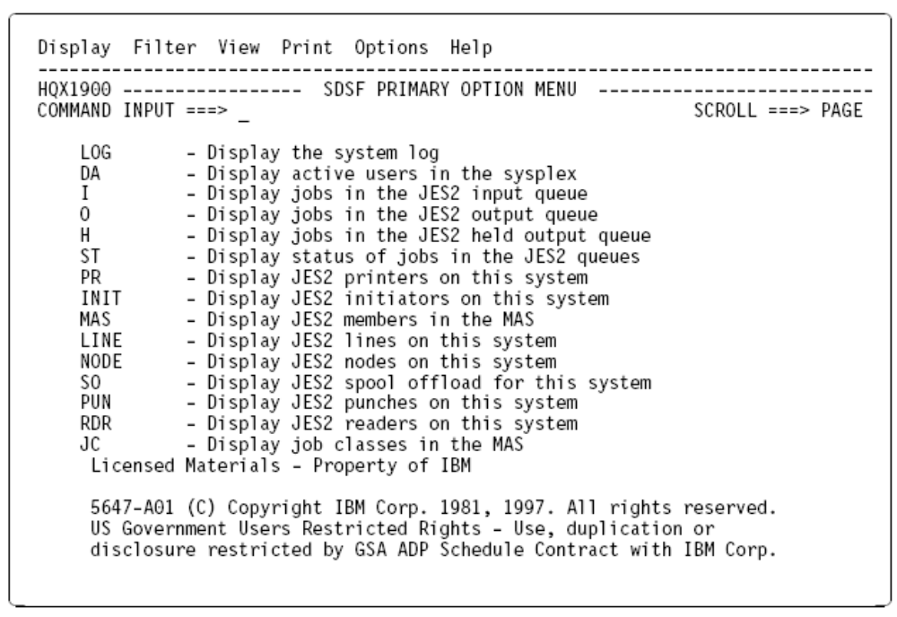
System Display and Search Facility (SDSF)
Type SDSF at any command line prompt and a similar panel above will be displayed

Slide 43
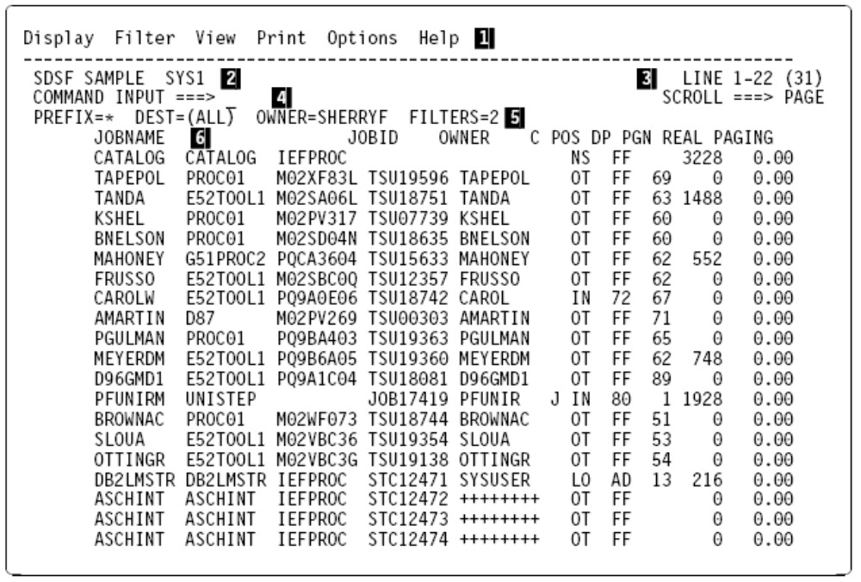
System Display and Search Facility (D A)

Slide 44
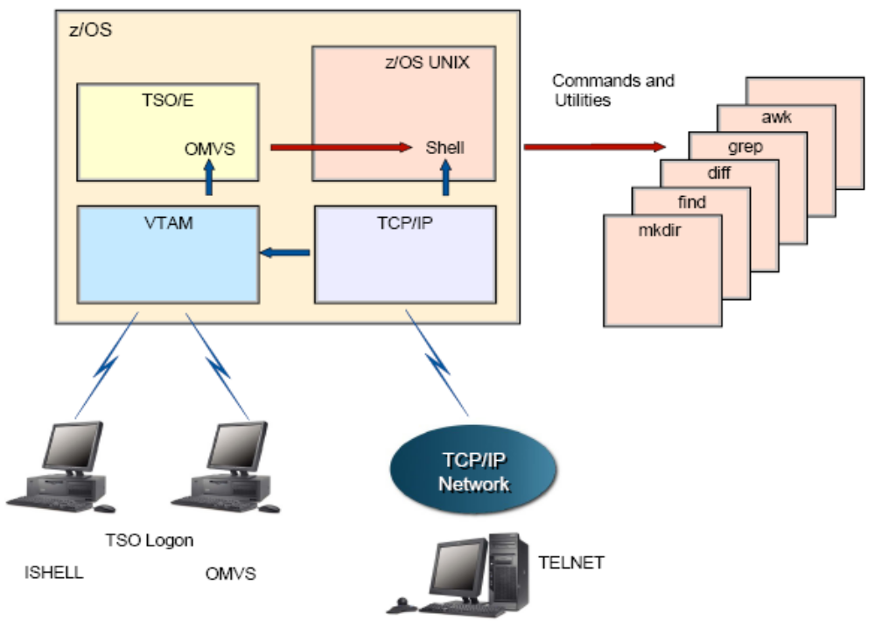
z/OS’ Unix Interactive Interface (Unix System Services)

Slide 45
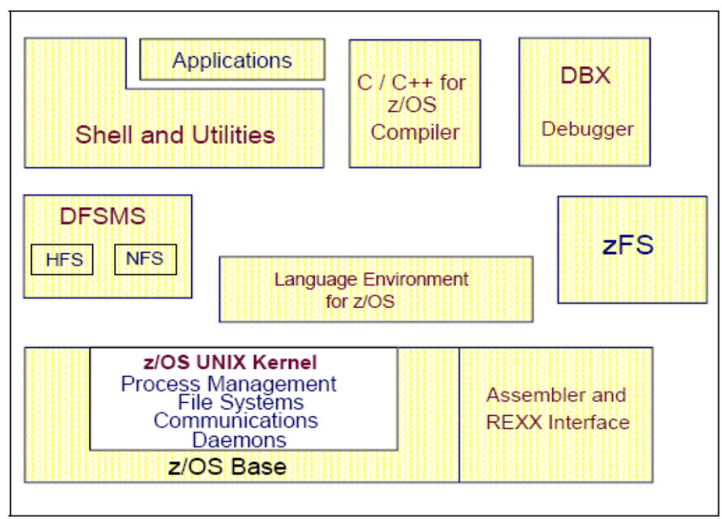
Unix is inherent in z/OS

Slide 46
z/OS UNIX interactive interfaces
Like TSO and ISPF, the z/OS UNIX shell and utilities provide an interactive interface to z/OS.
Use the UNIX shell to:
  Invoke shell scripts and utilities
  Write shell scripts (a list of shell commands created with the shell programming language)
  Run shell scripts and C language programs interactively.
Notes:
The z/OS UNIX shell and utilities provide an interactive interface to z/OS. The shell and utilities can be compared to the TSO function in z/OS. To perform some command requests, the shell calls other programs, known as utilities.
The shell can be used to:
Invoke shell scripts and utilities.
Write shell scripts (a named list of shell commands, using the shell programming language).
Run shell scripts and C language programs interactively, in the TSO background or in batch.

Slide 47
Invoking the UNIX shell
You can invoke the UNIX shell in any of these ways:
  From a 3270 display or a workstation running a 3270 emulator
  From a TCP/IP-attached terminal, using the rlogin and telnet commands
  From TSO by entering the OMVS command or the ISHELL command.
Notes:
The z/OS UNIX shell is based on the UNIX System V shell and has some of the features from the UNIX Korn shell. The POSIX standard distinguishes between a command, which is a directive to the shell to perform a specific task, and a utility, which is the name of a program callable by name from the shell. To the user, there is no difference between a command and a utility.
The z/OS UNIX shell provides the environment that has the most functions and capabilities. Shell commands can easily be combined in pipes or shell scripts, and thereby become powerful new functions. A sequence of shell commands can be stored in a text file that can be executed. This is called a shell script. The shell supports many of the features of a regular programming language.

Slide 48
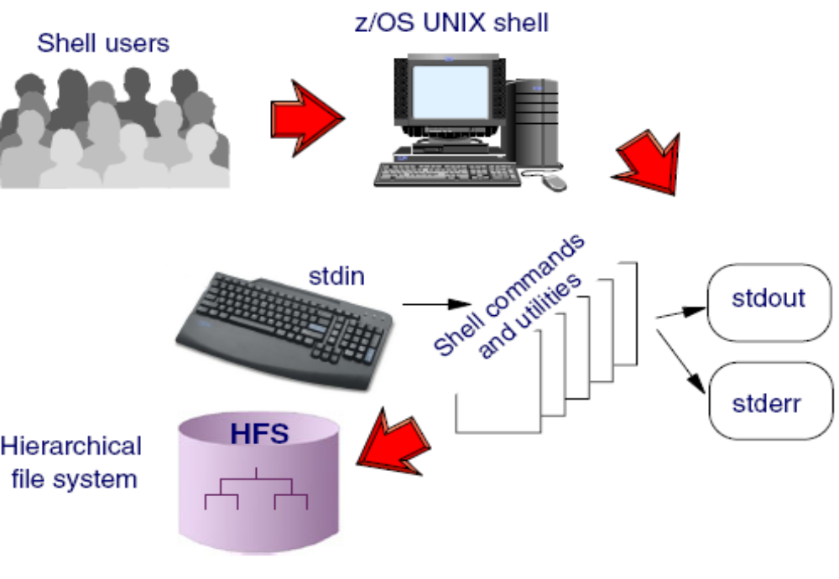
UNIX Shell

Slide 49
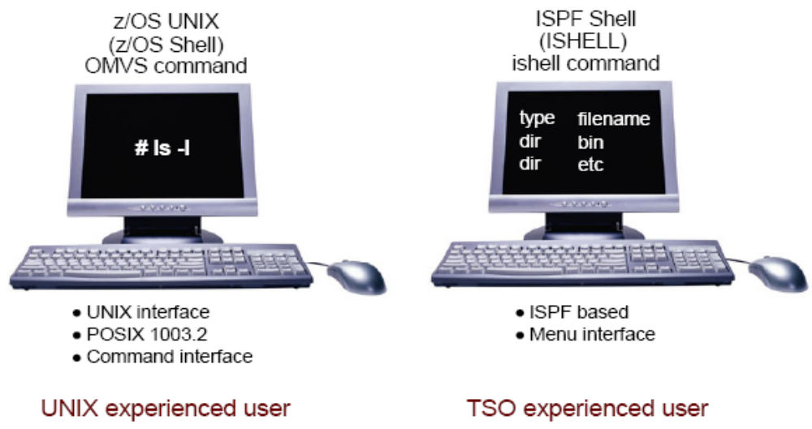
Unix Interfaces on TSO

Slide 50
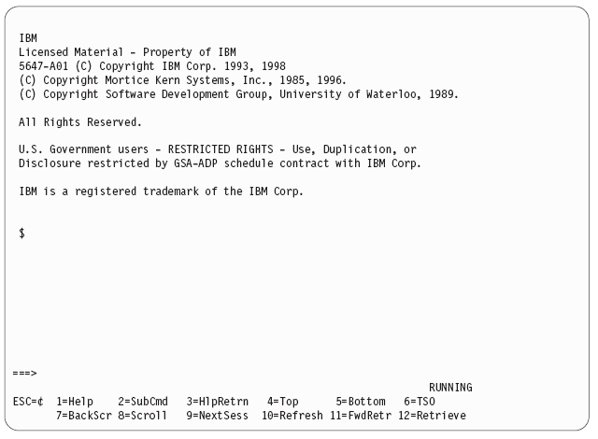
OMVS Shell
Enter any
Unix command

Slide 51
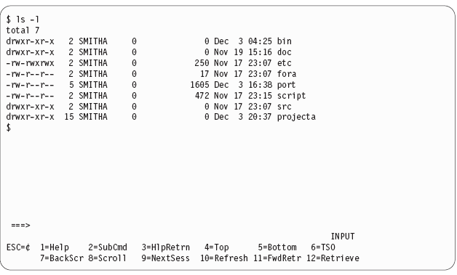
Displaying directories and files
ls -l

Slide 52
TSO commands used with z/OS UNIX
ISHELL -- This command invokes the ISPF shell.
  Intended for users more familiar with TSO/ISPF than UNIX
  Provides panels for working with UNIX files, mounting and unmounting file systems, and z/OS UNIX administration.
  z/OS programmers can do much of their work under ISHELL.
OMVS -- This command invokes the z/OS UNIX shell.
  Intended for users more familiar with UNIX than TSO/ISPF
  Allows the user to alternate between the shell and TSO
  UNIX programmers should find the z/OS UNIX shell programming environment familiar.
Notes:
OMVS for line commands, ISHELL for ISPF-like menus. The TSO commands used with z/OS UNIX are: ISHELL and OMVS.
The ISHELL command invokes the ISPF shell. ISHELL is a good starting point for users familiar with TSO and ISPF who want or need to use z/OS UNIX. ISHELL provides panels where users can work with the hierarchical file system. There are also panels for mounting and unmounting file systems and for doing some z/OS UNIX administration. Users whose primary interactive computing environment is TSO/E and ISPF can do much of their work in that environment.
The OMVS command is used to invoke the z/OS UNIX shell. Users whose primary interactive computing environment is a UNIX workstation find the z/OS UNIX shell programming environment familiar.

Slide 53
ISHELL command (ish)
A good starting point for TSO/ISPF users who want to use z/OS UNIX.
Under ISHELL, you can use action codes to:
  b Browse a file or directory
  e Edit a file or directory
  d Delete a file or directory
  r Rename a file or directory
  a Show the attributes of a file or directory
  c Copy a file or directory
Notes:
ISHELL provides an ISPF-like menu interface for working with files in UNIX directories.

Slide 54
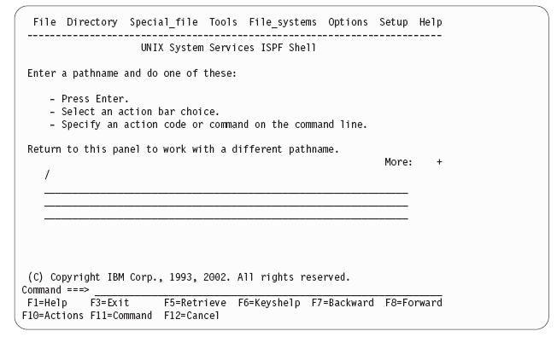
ISHell main panel

Slide 55
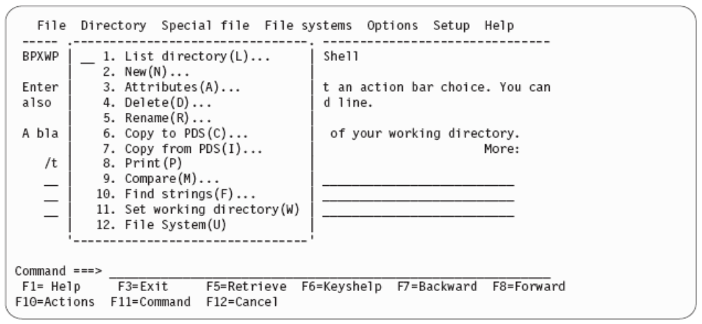
Pull Down Menu Bar - ISH

Slide 56
OMVS command shell session - summary
You use the OMVS command to invoke the z/OS UNIX shell.
Under the UNIX shell, users can:
  Invoke shell commands or utilities that request services from the system.
  Write shell scripts using the shell programming language.
  Run shell scripts and C-language programs interactively (in the foreground), in the background, or in batch.
Notes:
You use the OMVS command to invoke the z/OS UNIX shell. The shell is a command processor that you use to:
Invoke shell commands or utilities that request services from the system.
Write shell scripts using the shell programming language.
Run shell scripts and C-language programs interactively (in the foreground), in the background, or in batch.
Shell commands often have options (also known as flags) that you can specify, and they usually take an argument, such as the name of a file or directory. The format for specifying the command begins with the command name, then the option or options, and finally the argument, if any.
For example, in the following command:
ls -al /u/rogers
ls is the command name, and -al are the options.
This command lists the files and directories of the user. If the pathname is a file, ls displays information on the file according to the requested options. If it is a directory, ls displays information on the files and subdirectories therein. You can get information on a directory itself by using the -d option.
If you do not specify any options, ls displays only the file names. When ls sends output to a pipe or file, it writes one name per line; when it sends output to the terminal, it uses the -C (multi-column) format.

Slide 57
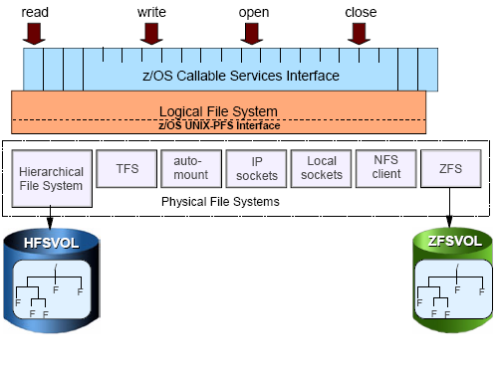
Unix File Systems on z?OS

Slide 58
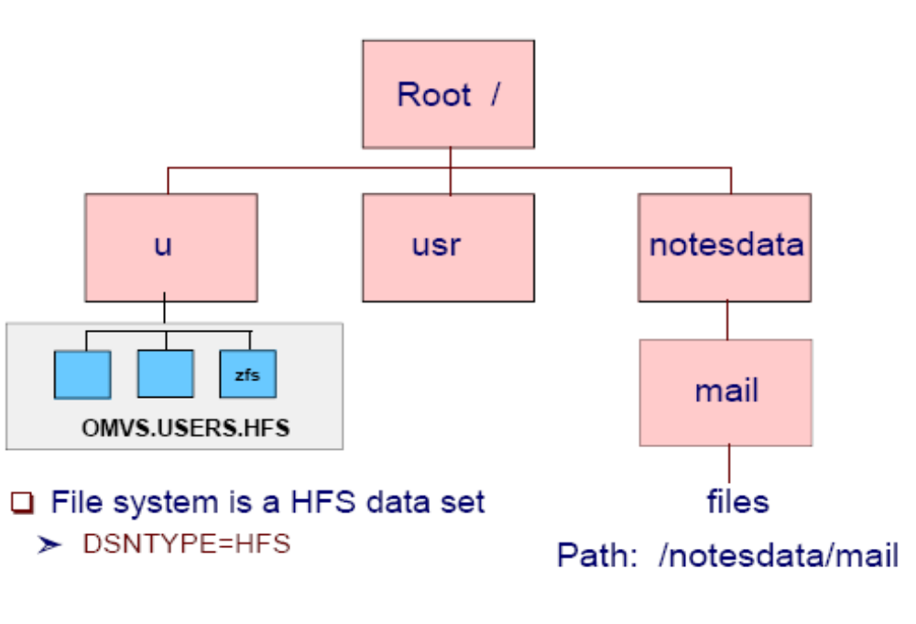
Structure of Hierarchical File System
Screenshot 2

Slide 59
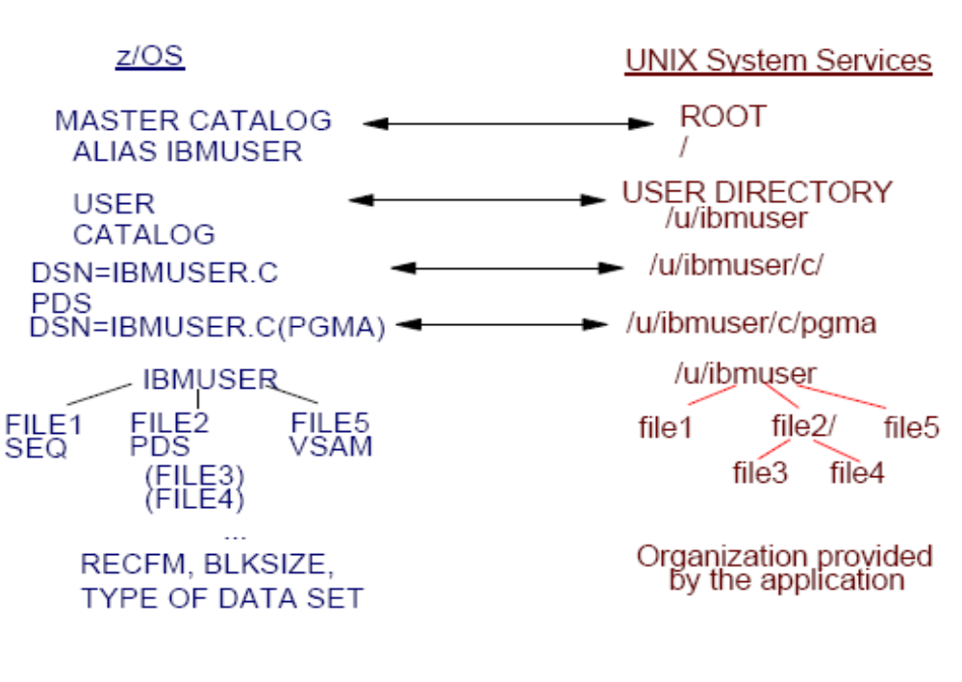
MVS Datasets and Unix Files

Slide 60
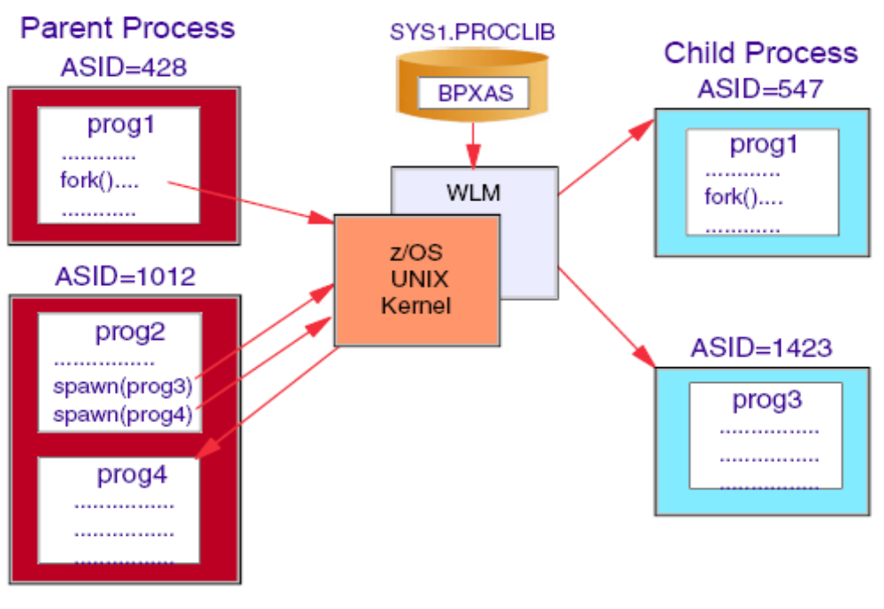
Unix Process

Slide 61
Direct login to the shell
rlogin
  When the inetd daemon is active, you can rlogin to the shell from a workstation. To log in, use the rlogin (remote log in) command syntax supported at your site.
telnet
  Also uses the inetd daemon
  inetd must be active and set up to recognize and receive the incoming telnet requests.
Notes:
To login directly to the z/OS UNIX shell, use one of the following solutions:
rlogin --- When the inetd daemon is set up and active, you can rlogin to the shell from a workstation that has rlogin client support and is connected through TCP/IP to the z/OS system (Figure 3-25 on page 3-30). To log in, use the rlogin (remote log in) command syntax supported at your site.
telnet --- Telnet support comes with the TCP/IP z/OS UNIX feature. It also uses the inetd daemon, which must be active and set up to recognize and receive the incoming telnet requests.
There are some differences between the asynchronous terminal support (direct shell login) and the 3270 terminal support (OMVS command):
You cannot switch to TSO/E. However, you can use the TSO SHELL command to run a TSO/E command from your shell session.
You cannot use the ISPF editor (this includes the oedit command, which invokes ISPF edit).

Slide 62
Summary
TSO allows users to logon to z/OS and use a limited set of basic commands in native mode.
ISPF is a menu-driven interface for user interaction with z/OS.
ISPF provides utilities, an editor and ISPF applications to the user. To the extent permitted by various security controls an ISPF user has full access to most z/OS system functions.
TSO ISPF should be viewed as a system management interface and a development interface for traditional z/OS programming.
The z/OS UNIX shell and utilities provide a command interface to the z/OS UNIX environment. You can access the shell either by logging on to TSO/E or by using the remote login facilities of TCP/IP (rlogin).
If you use TSO/E, a command called OMVS creates a shell for you. You can work in the shell environment until exiting or temporarily switching back to the TSO/E environment.
Notes:
TSO allows users to log on to z/OS and use a limited set of basic commands. This is sometimes called using TSO in its native mode.
ISPF is a menu-driven interface for user interaction with a z/OS system. The ISPF environment is executed from native TSO.
ISPF provides utilities, an editor and ISPF applications to the user. To the extent permitted by various security controls an ISPF user has full access to most z/OS system functions.
TSO/ISPF should be viewed as a system management interface and a development interface for traditional z/OS programming.
The z/OS UNIX shell and utilities provide a command interface to the z/OS UNIX environment. You can access the shell either by logging on to TSO/E or by using the remote login facilities of TCP/IP (rlogin).
If you use TSO/E, a command called OMVS creates a shell for you. You can work in the shell environment until exiting or temporarily switching back to the TSO/E environment.
Note that you can logon as a TSO user and telnet into UNIX System Services.

